Slide 1
Lending Club Case Study Amol Joshi Email ID: amoljoshi_007@yahoo.com Batch – ML C67

Slide 2
Contents
Problem Statement
Approach
Analysis
Recommendations

Slide 3
Problem Statement
Lending Club is the leading online loan marketplace, offering a wide range of ﬁnancial products including personal loans, business loans, and ﬁnancing for medical procedures. One of the biggest challenges for lenders is managing credit risk, which is the ﬁnancial loss that occurs when borrowers default on their loans.
To address this challenge, Lending Club is focused on understanding the key drivers behind loan defaults, including the factors that strongly indicate when a borrower is likely to default. By identifying these key variables, Lending Club can better manage its portfolio and assess risks to ensure the best possible outcomes for both borrowers and investors.

Slide 4
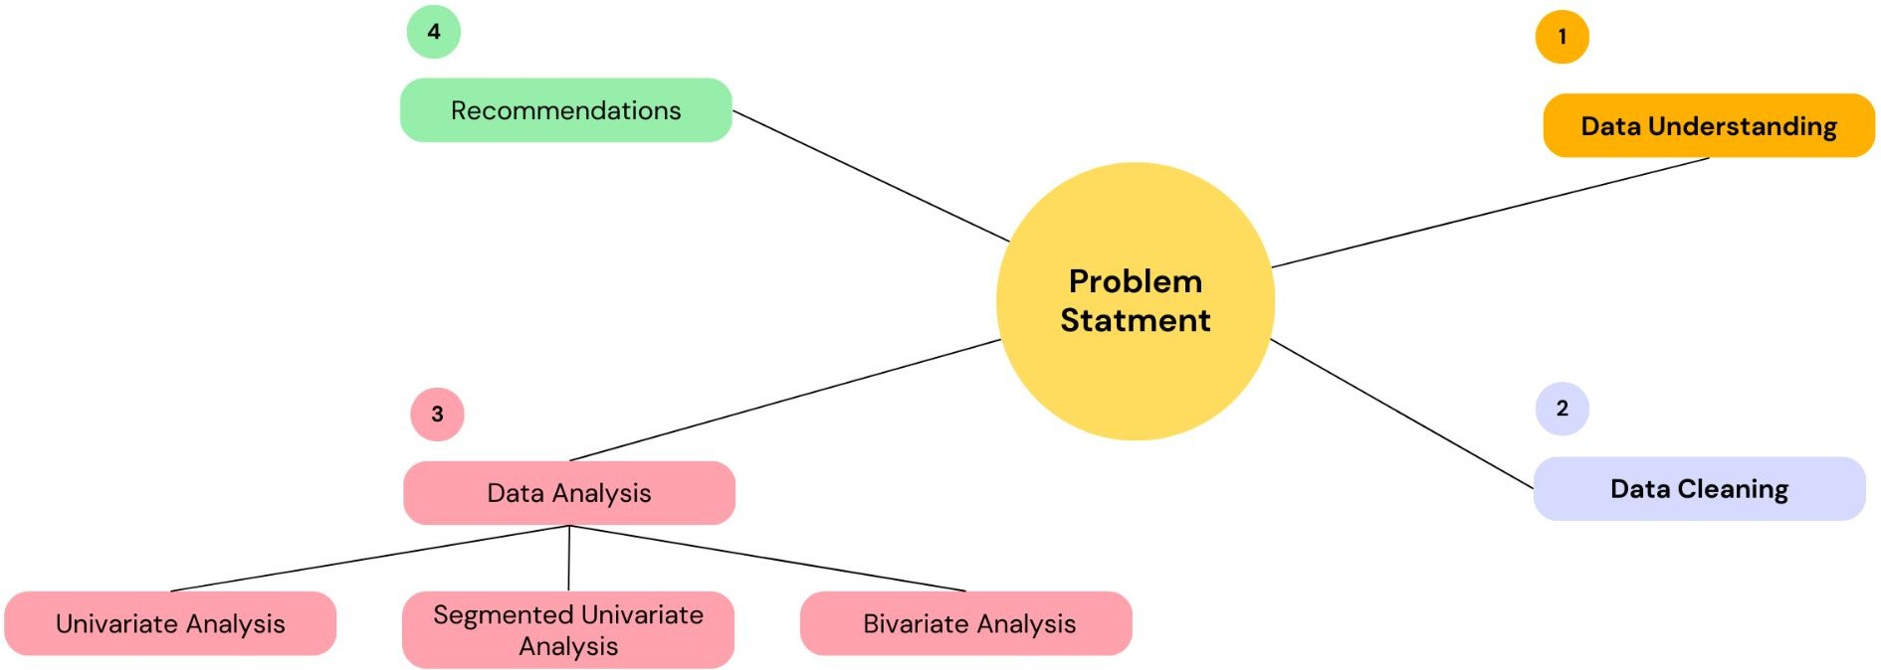
Problem solving approach

Slide 5
Data Cleaning
We removed columns with Null % greater than 30 %
We removed trailing spaces from the categorical data
We dropped columns which had 1 unique values
We dropped columns which had no signiﬁcant impact on loan default prediction
We dropped records for which loan payment is in progress
loan_amnt , funded_amnt , int_rate & revol_util casted to ﬂoat as they are amount & rate of interest respectively
issue_d converted to date format and month & year derived as additional columns
loan_status_num created to identify loan status numerically

Slide 6
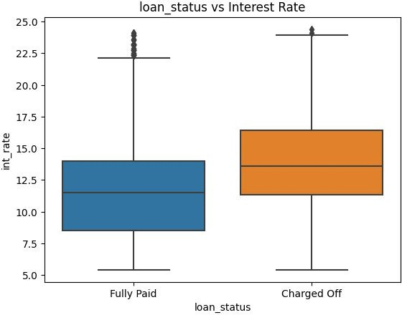
Interest Rates
Interest rates less than 10% have very low chances of resulting in charge-offs. The minimum interest rate for charge-offs is 5.4%.
According to the quartile distribution, interest rates above 14% have a higher probability of resulting in default.
The proportion of charge-offs increases with higher interest rates.

Slide 7
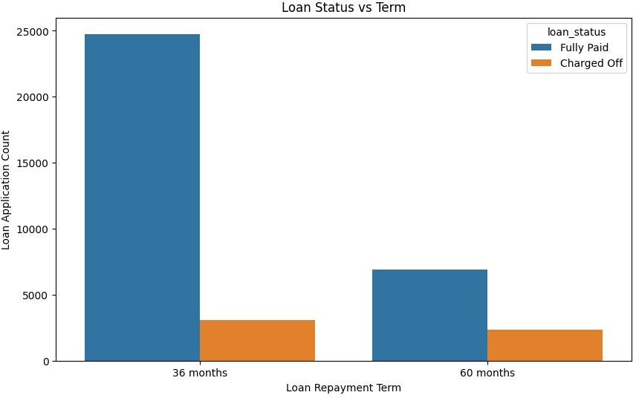
Term
People who have taken loan for a tenure of 60 months have higher chances of defaulting

Slide 8
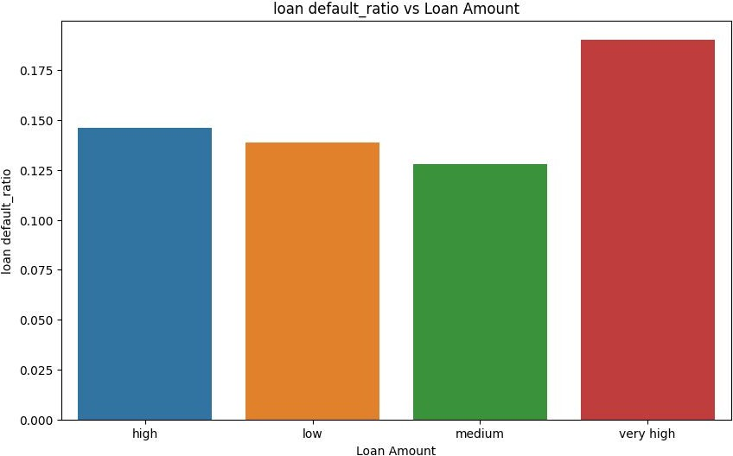
Loan Amount
Higher the loan amount, greater the chance of the loan getting default.

Slide 9
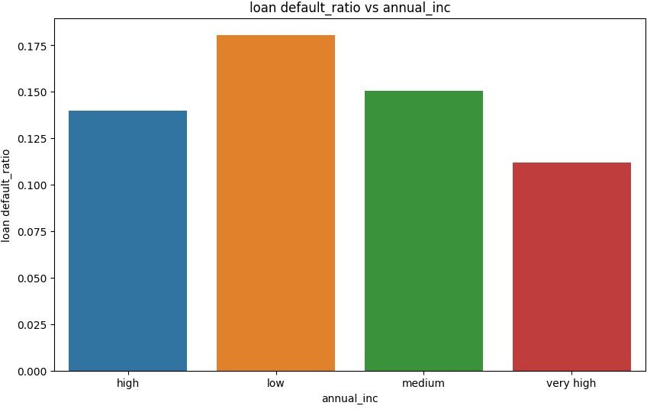
Annual Income
Low Annual Income have slight chances to default

Slide 10
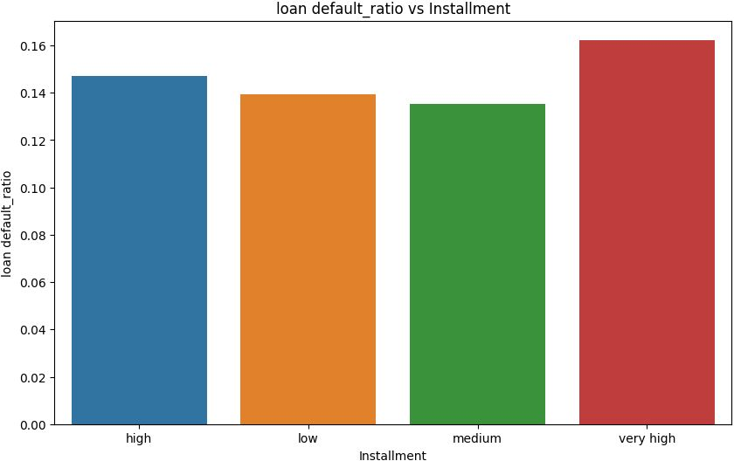
Installment
Higher installment have around 16 % chances of default

Slide 11
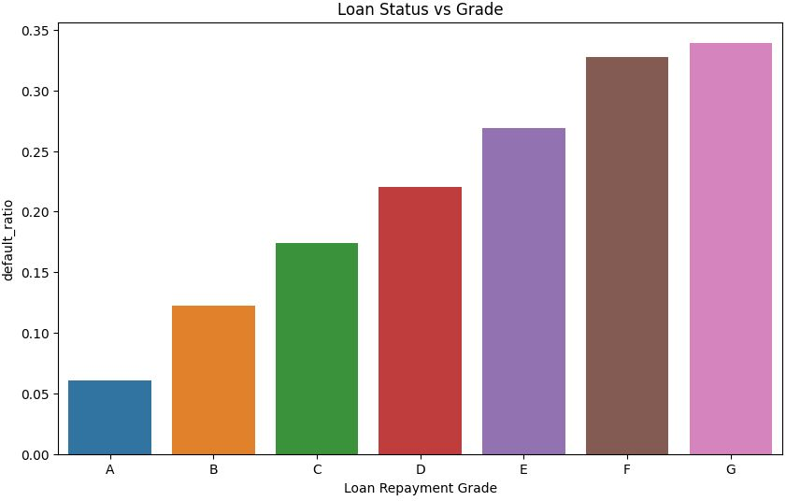
Grade
Grade F & G have highest chances of default
Grade A has the least chance of default
As we saw earlier Grade and sub grade have same trend hence this behaviour would be same in subgrade also , where in subgrades of F & G would be high risk to default

Slide 12
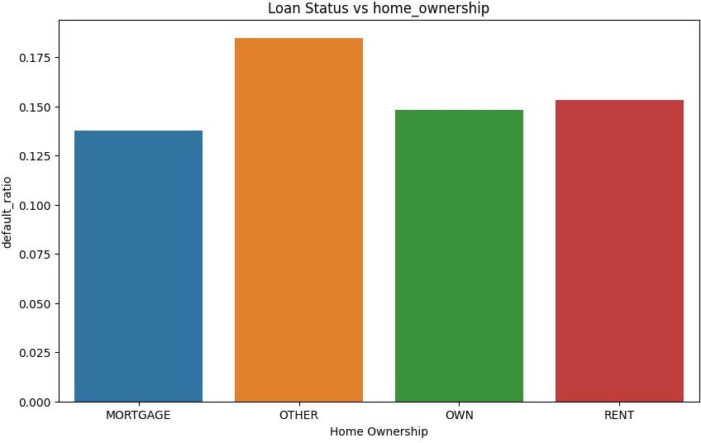
Home Ownership
There is slight impact of other category in home_ownership to default

Slide 13
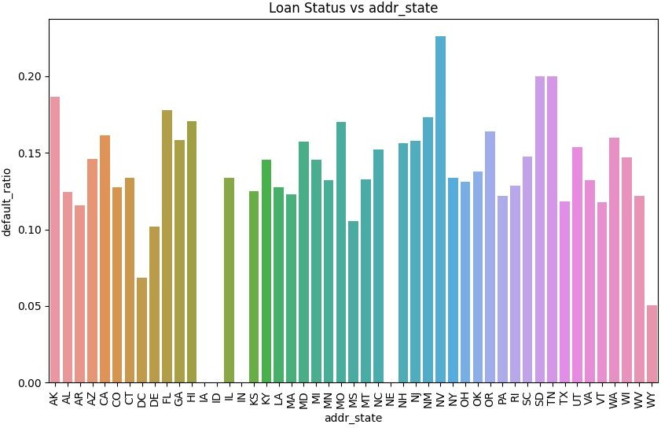
Address State
High chances of default are in NV,SD,TN,NM,MO & the least are in IA,ID,IN,NE

Slide 14
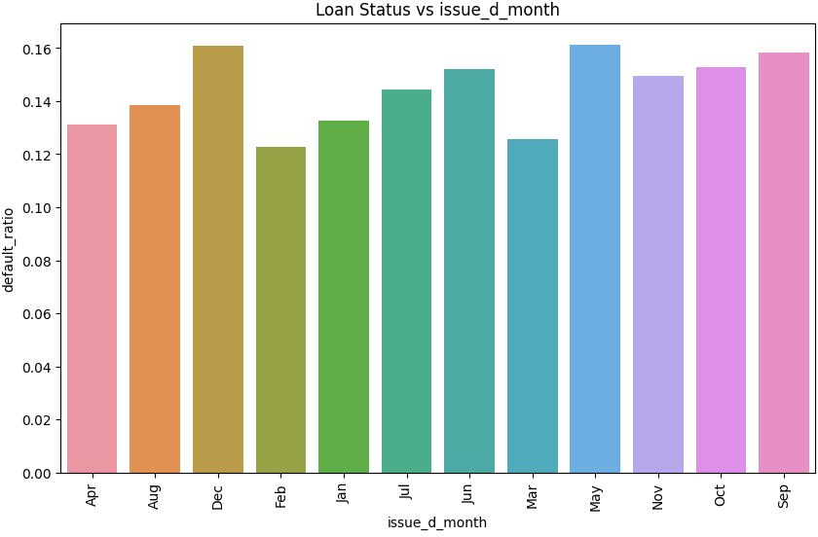
Issue Month
The issuance of loans in May, September, October, November, and December has minimal impact on loan defaults.

Slide 15
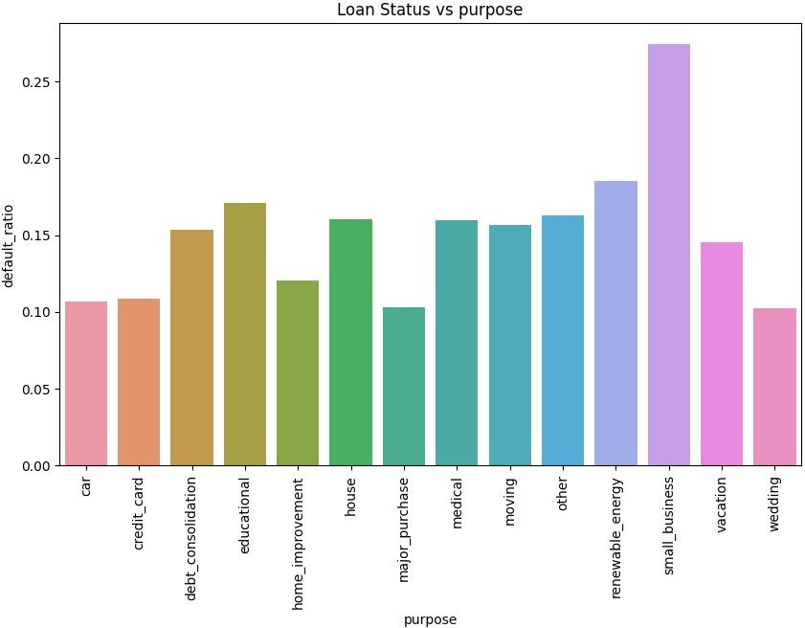
Purpose
Small businesses, renewable energy, and educational purposes have a higher probability of defaulting on their loans.

Slide 16
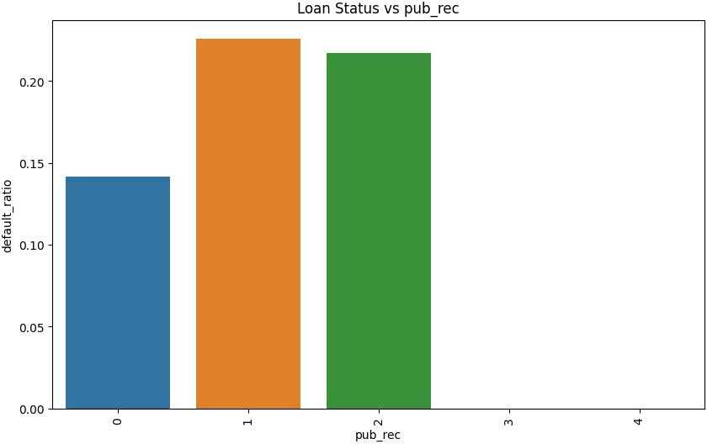
Number of derogatory public records
Borrowers with derogatory public records, speciﬁcally those with public records marked as 1 or 2, have a higher likelihood of defaulting on their loans.

Slide 17
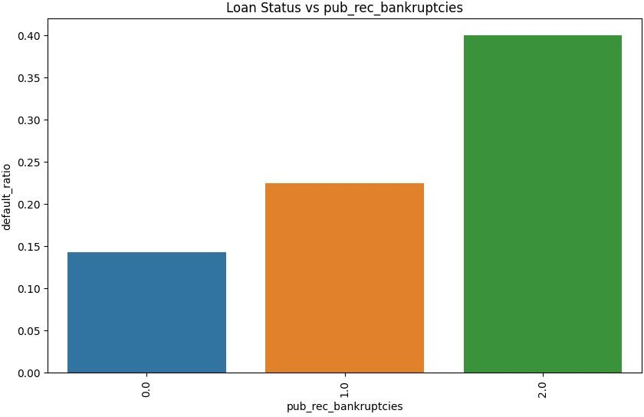
Number of public record bankruptcies
Borrowers with public bankruptcy records (1 & 2) are more likely to default on their loans.

Slide 18
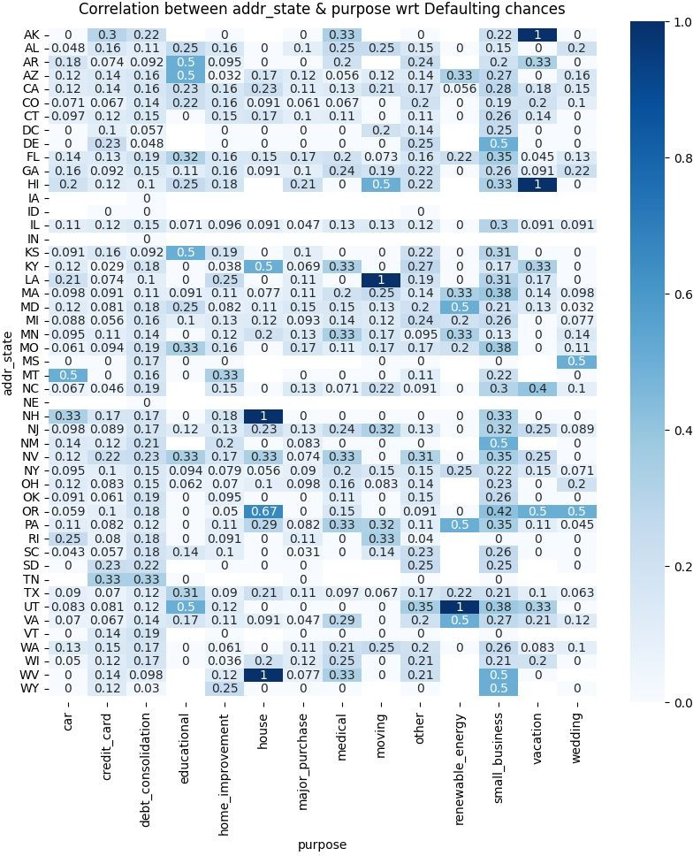
addr_state & purpose wrt Defaulting chances
Based on the above plot, the following observations can be made regarding risky loans:
Education loans in AR, KS, and UT
Small business loans in DE, NM, WV, and WY
Vacation loans in AK and HI
Housing loans in NH and WV
Car loans in MT
Moving loans in LA and HI

Slide 19
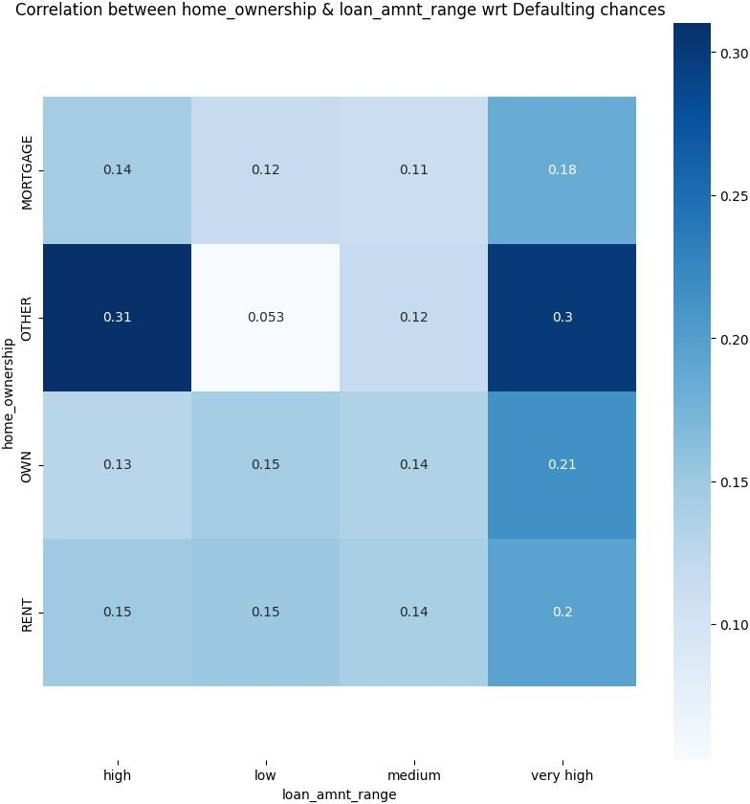
Home_ownership & loan_amnt_range wrt Defaulting chances
People with High and Very High Income with Homeownership(other) tend to default on Loan

Slide 20
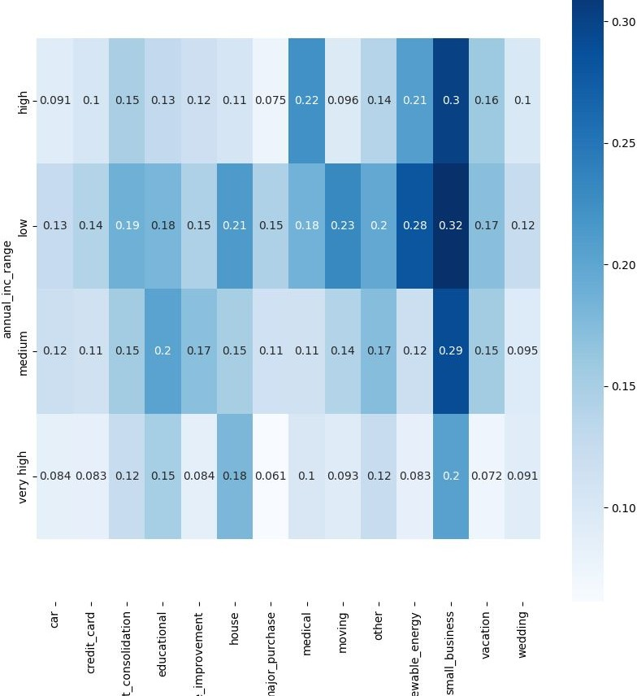
Annual income & purpose wrt Defaulting chances
People with both high and low income who are involved in small business tend to have a higher tendency to default on loans.

Slide 21
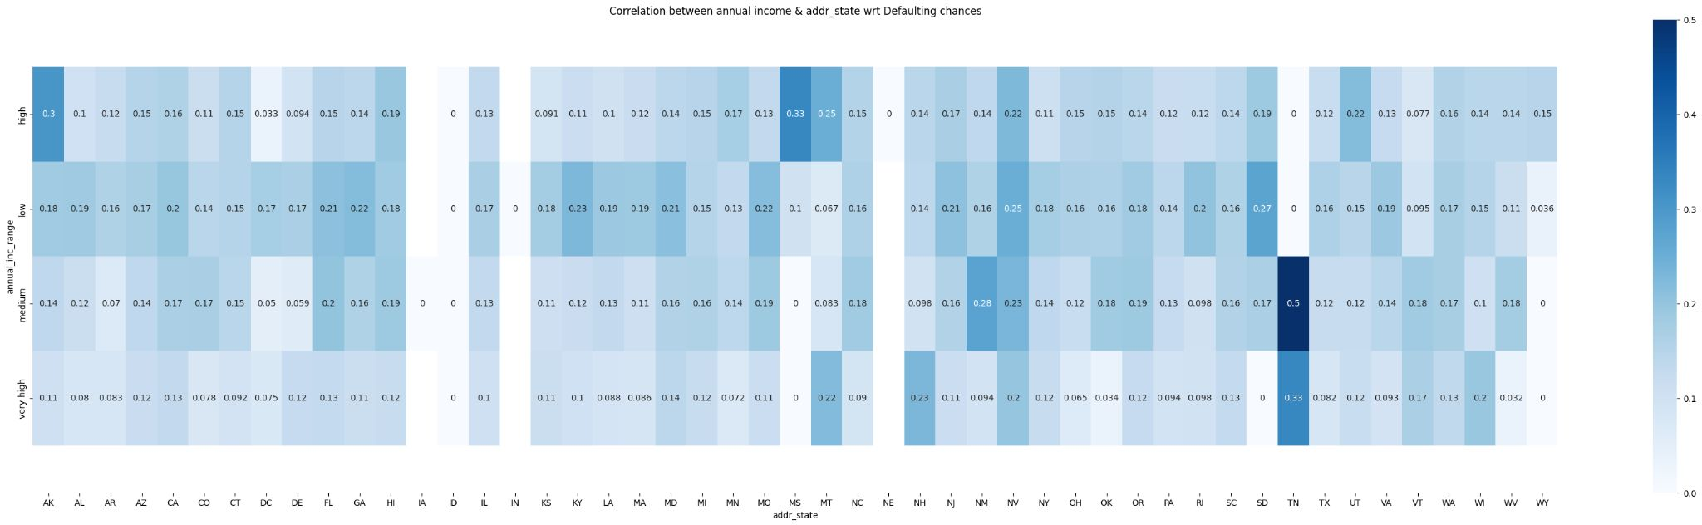
Annual income & addr_state wrt Defaulting chances
Based on the analysis, it was observed that people with high and low incomes in small business tend to default on loans. Additionally, individuals with high incomes in AK, MS, and MT have a medium chance of default, while those with medium incomes in TN and NM have a high chance of default. Lastly, very
high-income earners in TN, NH, and MT have a medium chance of default."

Slide 22
Recommendations
Interest rate more than 14% have high probability to default
People who have taken loan for a tenure of 60 months have higher chances of defaulting
Higher the loan amount, greater the chance of the loan getting default.
Low Annual Income have slight chances to default
Higher installment have around 16 % chances of default(300 +)
Grade F & G along with its subgrade have highest chances of default
There is slight impact of other category in home_ownership to default
High chances of default are in NV,SD,TN,NM,MO
Small Business , renewable energy ,educational purpose have higher chances to default
Derogatory public records (1 & 2) have high default chances

Slide 23
Recommendations
Public bankruptcy records (1 & 2) have higher chances to default
Vacation loans in AK, HI
Housing loans in WV,NH
Small Business in DE, NM, WV, WY
Car Loan in MT
Moving Loan in LA , HI
People with High and Very High Income with Homeownership(other) tend to default on Loan
High Income People in AK,MS,MT have medium chances of default
Medium Income people in TN,NM have high chances of default
Very High Income people in TN,NH,MT have medium chances of default

Slide 24
Thankyou

